Slide 1
Rockbuster
Stealth
Online Store Launch Strategy Guide
By Andres Cannizzo

Slide 2
Table of contents
Data Summary
Highest and Lowest Film Revenue
Top 10 Genres
Top 10 Actors
Top 10 Customers
Top 10 Countries
Final thoughts and Actionable Steps
End

Slide 3







Data Summary
5 Day avg
rental
Duration
$2.98 Avg
Rental
Rate
1001 Films
NC-17
Most rented
rating
$19.98 AVG
Replacement
Cost
21 Categories
Sports
Most rented
genre
599 Customers

Slide 4

Highest and Lowest Revenue
Films
Top 5
Bottom 5
Title
Revenue
Title
Revenue
Telegraph Voyage
Zorro Ark
Wife Turn
Innocent Usual
Hustler Party
$ 215.75
$199.72
$198.73
$191.74
$190.78
Texas Watch
Oklahoma Jumanji
Duffel Apocalypse
Freedom Cleopatra
Rebel Airport
$ 5.94
$5.94
$5.94
$5.95
$6.93
Knowing this information can help us learn about our customer’s
behavior and which kinds of movies we should be promoting to them.

Slide 5
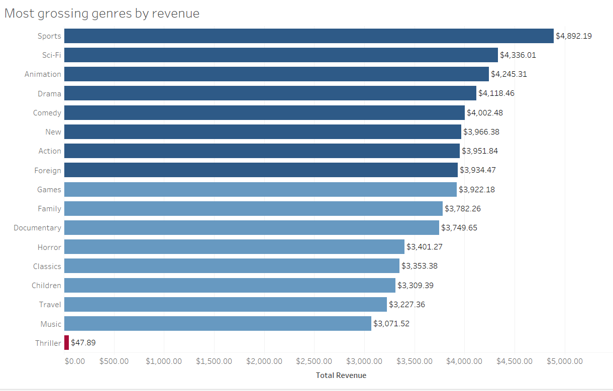
Our most performing genres are Sports, Sci-Fi, Animation, Drama and Comedy.

Slide 6
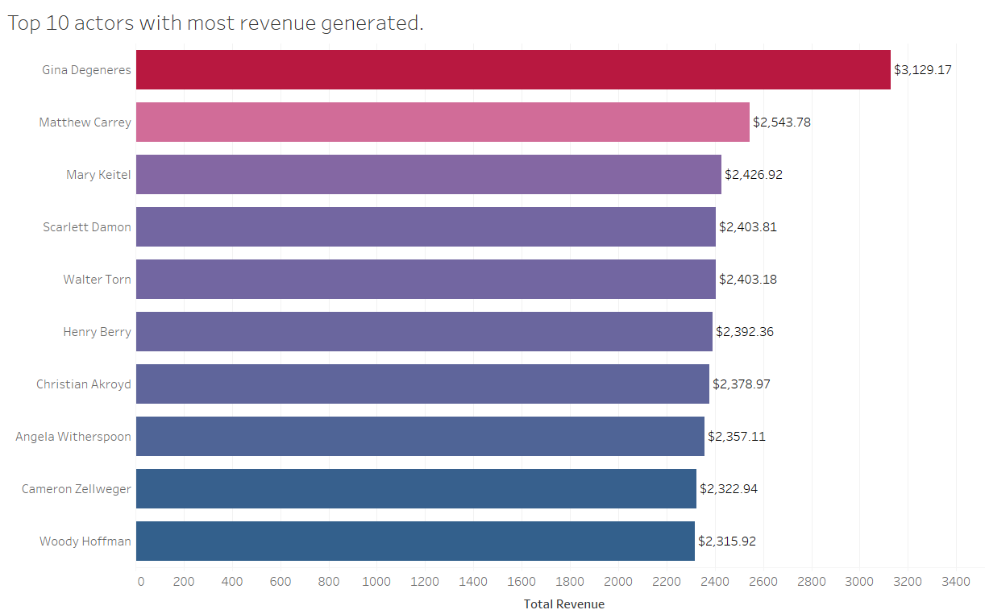
Top 10 actors in the database with the most revenue.

Slide 7
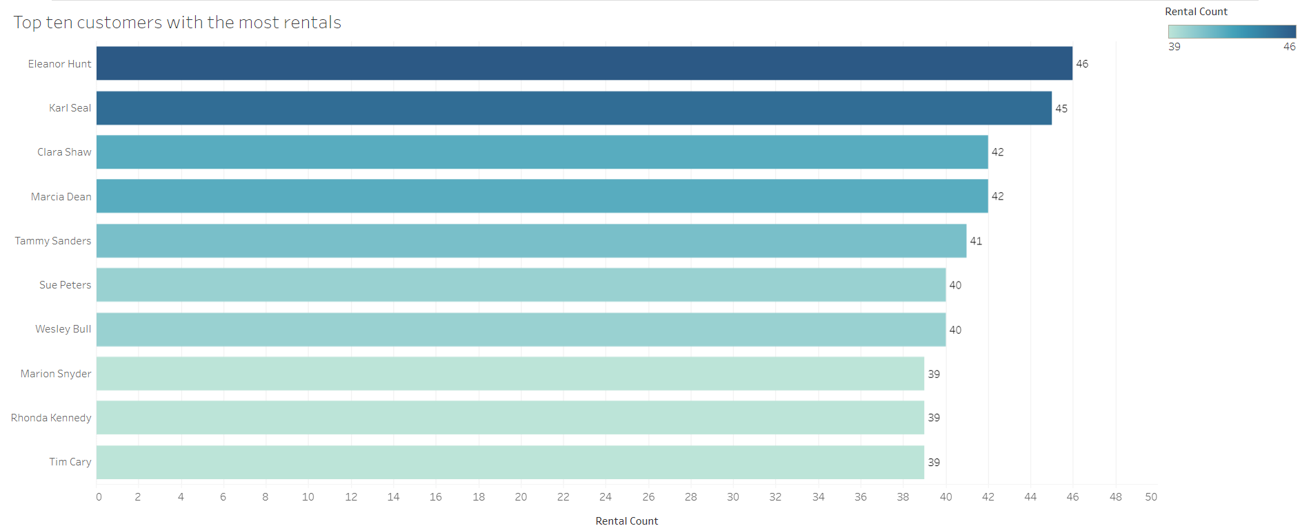
Top 10 customers in the database
with the most rentals

Slide 8
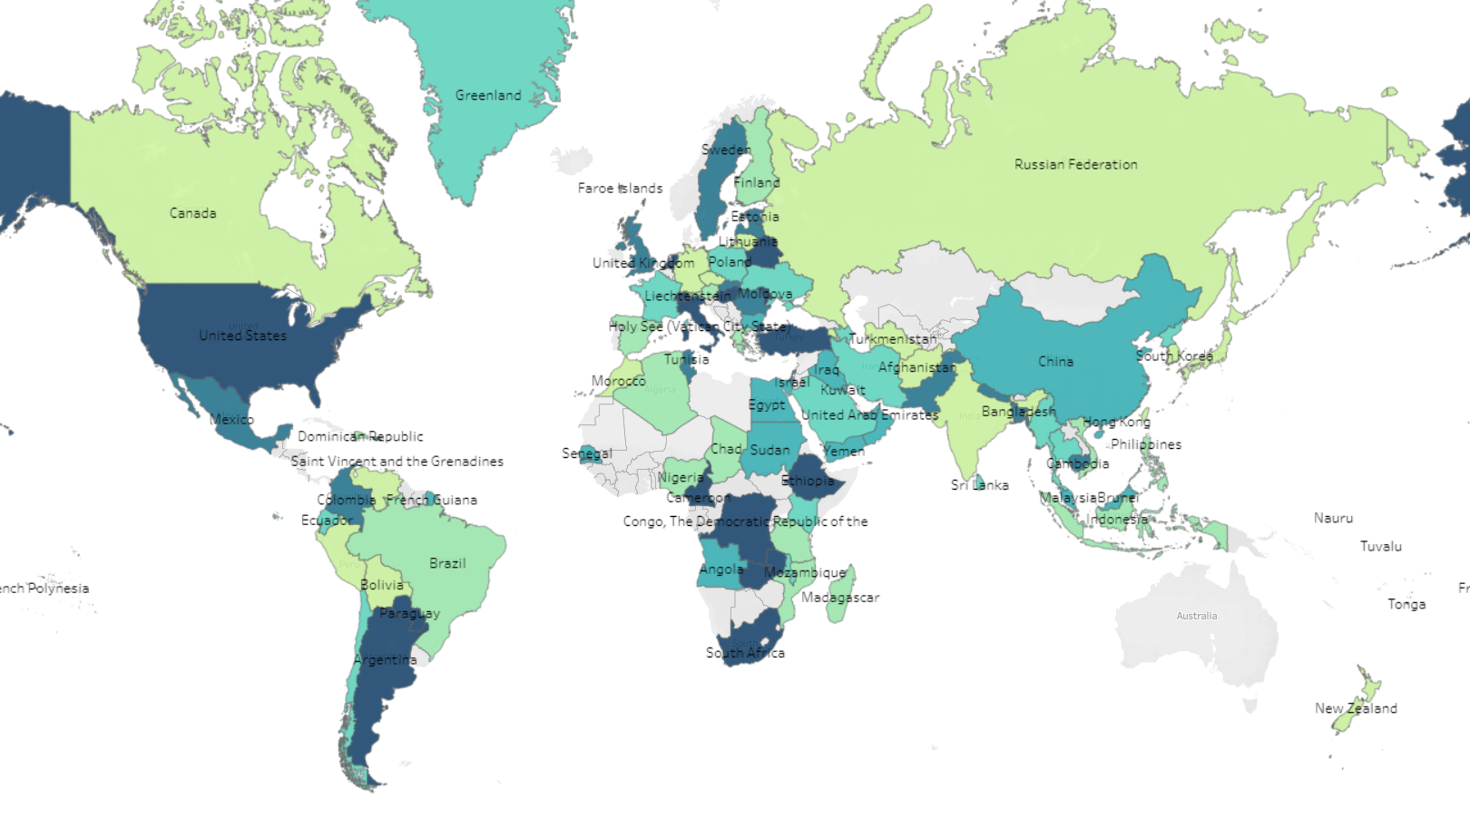
World Map Slide
Top 10 Countries by Customers
India
China
United States
Japan
Mexico
Brazil
Russian Federation
Philippines
Turkey
60
53
36
31
30
28
28
20
15
$6,032.79
$5,247.04
$3,694.27
$3,121.52
$2,984.82
$2,919.19
$2,765.62
$2,219.70
$1,498.49
We should be focusing on the top 5 countries in this list to generate the most revenue.

Slide 9
Final Thoughts:
Focus on adding a bigger movie catalog related to Top 5 genres which are
Sports, Sci-fi Animations, Drama, and Comedy.
2. Promote more movies that are related to our most revenue-generated films and that has actors that we generated the most with.
3. Ask our most loyal customers for feedback on how we can improve the site.
4. Target the Top 10 Countries which have the biggest market for us with the
most revenue.

Slide 10
My Recommendations:
Offer live sports channels and a subscription-based service along with a
1-week free trial to your online store in order to compete with the likes of
Netflix and Amazon Prime. Adjust subscription/rental price to the countries’ cost of living.
2. Add extra languages to the movies such as Spanish, Mandarin, Japanese,
and Portuguese. Add languages in correspondence to the countries with
the most customers.

Slide 11
Thanks

